Slide 1


Systems Analysis & Design
Eleventh Edition
Chapter # 4
Information Gathering: Interactive Methods
Copyright © 2024, 2019, 2014 Pearson Education, Inc. All Rights Reserved
Notes:
If this PowerPoint presentation contains mathematical equations, you may need to check that your computer has the following installed:
1) MathType Plugin
2) Math Player (free versions available)
3) NVDA Reader (free versions available)

Slide 2
Learning Objectives
4.1 Learn the art of interviewing by constructing meaningful questions and conducting the interview.
4.2 Understand the purpose of listening to user stories and why they are useful in systems analysis.
4.3 Grasp the concept of joint application design (J A D) and when to use it,
4.4 Design and administer effective questionnaires.
4.5 Learn different ways to prioritize requirements.

Slide 3
Interactive Methods to Elicit Human Information Requirements
Interviewing
Joint Application Design (J A D)
Questionnaires
Requirements Prioritization
Notes:
The first three methods involve talking with and listening to people in the organization in order to understand their interactions with technology through a series of carefully composed questions. Requirement prioritization involves the client or customer as well.

Slide 4
Major Topics (1 of 2)
Interviewing
  Interview preparation
  Question types
  Arranging questions
  The interview report
User Stories

Slide 5
Major Topics (2 of 2)
Joint Application Design (J A D)
  Involvement
  Location
Questionnaires
  Writing questions
  Using scales
  Design
  Administering

Slide 6
Interviewing
Interviewing is an important method for collecting data on human and system information requirements
Interviews reveal information about:
  Interviewee opinions
  Interviewee feelings
  Goals
  Key H C I concerns
Notes:
Opinions – may be more revealing and more important than facts. By seeking opinion rather than fact you can discover key problems.
Feelings – you can understand the organization’s culture more fully by listening to the feelings of the respondent.
Goals – project the organization’s future. You may not be able to determine goals through any other method.
HCI – the ergonomic aspects, the system usability, how pleasing and enjoyable the system is, and how useful it is in supporting individual tasks.

Slide 7
Five Steps in Interview Preparation
Reading background material
Establishing interview objectives
Deciding whom to interview
Preparing the interviewee
Deciding on question types and structure
Notes:
Reading background material—read and understand as much background information about the interviewees and their organization as possible.
Corporate Web site
Current annual report
Corporate newsletter
Any publication sent out to explain the organization to the public
Standard & Poor’s
Try to build a common vocabulary to better phrase interview questions and to maximize the interview time.
Establishing interview objectives—four to six key areas concerning HCI, information processing, and decision-making behavior.
Deciding whom to interview—strive for balance so that as many users’ needs are addressed as possible.
Preparing the interviewee—call ahead or send an email message; with the advent of Covid 19 and other prohibitions against meeting in public interviews may be conducted using tools such as Zoom, Google Meet, Microsoft Teams, or other video-calling or video-conferencing options; keep interviews within 45 minutes to an hour at the most.
Deciding on question types and structure—write questions to cover the key areas of decision making that you discovered when you ascertained interview objectives.

Slide 8
Question Types
Open-ended
Closed
Probes
Notes:
Each question type can accomplish something a little different from the other, and each has benefits and drawbacks.

Slide 9
Open-Ended Questions
Open-ended interview questions allow interviewees to respond how they wish without length or structure limitations
Open-ended interview questions are appropriate when the analyst is interested in breadth and depth of reply
Notes:
“Open” describes the interviewee’s options for responding. They are open.

Slide 10
Figure 4.2 Open-Ended Interview Questions
What’s your opinion of the current state of business-to-business ecommerce in your firm?
What are the critical objectives of your department?
Once the data are submitted via the website, how are they processed?
Describe the monitoring process that is available online.
What are some of the common data entry errors made in this department?
What are the biggest frustrations you’ve experienced during the transition to ecommerce?

Slide 11
Advantages of Open-Ended Questions (1 of 2)
Puts the interviewee at ease
Allows the interviewer to pick up on the interviewee’s vocabulary
Provides richness of detail
Reveals avenues of further questioning that may have gone untapped

Slide 12
Advantages of Open-Ended Questions (2 of 2)
Provides more interest for the interviewee
Allows more spontaneity
Makes phrasing easier for the interviewer
Useful if the interviewer is unprepared

Slide 13
Disadvantages of Open-Ended Questions
May result in too much irrelevant detail
Possibly losing control of the interview
May take too much time for the amount of useful information gained
Potentially seeming that the interviewer is unprepared
Possibly giving the impression that the interviewer is on a “fishing expedition”
Notes:
The analyst needs to carefully consider the implications of using open-ended questions for interviewing.

Slide 14
Closed Interview Questions
Closed interview questions limit the number of possible responses
Closed interview questions are appropriate for generating precise, reliable data that is easy to analyze
The methodology is efficient, and it requires little skill for interviewers to administer
Notes:
The alternative to open-ended questions.

Slide 15
Figure 4.3 Closed Interview Questions
How many times a week is the project repository updated?
On average, how many calls does the call center receive monthly?
Which of the following sources of information is most valuable to you?
  Completed customer complaint forms
  Email complaints from consumers who visit the website
  Face-to-face interaction with customers
  Returned merchandise
List your top two priorities for improving the technology infrastructure.
Who receives this input?

Slide 16
Benefits of Closed Interview Questions
Save interview time
Easily compare interviews
Quickly get to the point
Maintain control of the interview
Cover a large area quickly
Obtain relevant data

Slide 17
Disadvantages of Closed Interview Questions
May be boring for the interviewee
May fail to obtain rich details
May miss some main ideas
May fail to build rapport between interviewer and interviewee
Notes:
As the interviewer you must think carefully about the question types you will use.

Slide 18
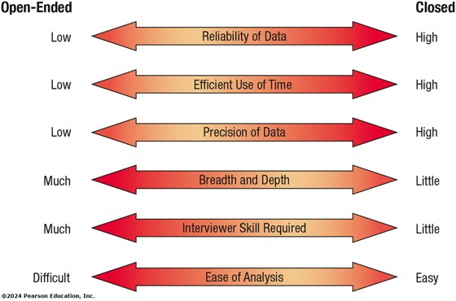
Figure 4.5 Attributes of Open-Ended and Closed Questions
Notes:
Choosing one question type over the other involves a trade-off; although an open-ended question affords breadth and depth of reply, responses to open-ended questions are difficult to analyze.
Long Description:
The information is as follows.
1. Reliability of data is low in open ended question and high in closed ended question.
2. Efficient use of time is low in open ended question and high in closed ended question.
3. Precision of data is low in open ended question and high in closed ended question.
4. Breadth and depth is much in open ended question and little in closed ended question.
5. Interviewer skill required is much in open ended question and little in closed ended question.
6. Ease of analysis is difficult in open ended question and easy in closed ended question.

Slide 19
Dichotomous Questions
Dichotomous questions are those that may be answered with a “yes” or “no” or “agree” or “disagree”
Dichotomous questions should be used sparingly
A special kind of closed question
Notes:
This type of closed question limits the interviewee even further by allowing a choice on either “pole,” such as yes or no, true or false, agree or disagree.

Slide 20
Probes
Probing questions elicit more detail about previous questions
The purpose of probing questions is:
  To get more meaning
  To clarify
  To draw out and expand on the interviewee’s point
May be either open-ended or closed
Notes:
Used as a follow-up question.
The strongest probe is simply—Why?
It is essential to probe so that we don’t accept superficial answers.

Slide 21
Arranging Questions
Pyramid
  Starts with closed questions and works toward open-ended questions
Funnel
  Starts with open-ended questions and works toward closed questions
Diamond
  Starts with closed, moving toward open-ended, and ends with closed questions
Notes:
There are two ways of organizing interviews—pyramid and funnel, the diamond approach combines both.

Slide 22
Pyramid Structure
Begins with very detailed, often closed questions
Expands by allowing open-ended questions and more generalized responses
Is useful if interviewees need to be warmed up to the topic or seem reluctant to address the topic
Notes:
Inductive organization of interview questions.
Also, useful if you want an ending determination about the topic.

Slide 23
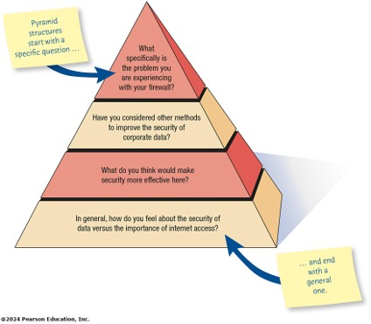
Figure 4.7 Pyramid Structure for Interviewing Goes from Specific to General Questions
Notes:
Long Description:
Moving from top to bottom, the questions depicted areas follows.
1. What specifically is the problem you are experiencing with your firewall?
2. Have you considered other methods to improve the security of corporate data?
3. What do you think would make security more selective here?
4. In general, how do you feel about the security of data versus the importance of internet access?
A sticky note pointing toward the first question reads, Pyramid structures start with a specific question and another pointing toward the last question reads, and end with a general one.

Slide 24
Funnel Structure
Begins with generalized, open-ended questions
Concludes by narrowing the possible responses using closed questions
Provides an easy, nonthreatening way to begin an interview
Is useful when the interviewee feels emotionally about the topic
Notes:
Deductive organization of interview questions.

Slide 25
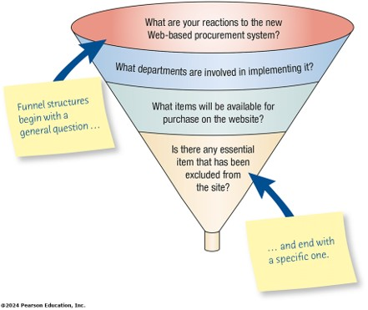
Figure 4.8 Funnel Structure for Interviewing Begins with Broad Questions Then Funnels to Specific Questions
Notes:
Long Description:
The funnel structure begins with a general question and ends with a specific one. Moving from top to bottom, the questions depicted are as follows.
1. The contents of the structure from top to bottom are as follows.
2. What departments are involved in implementing it?
3. What items will be available for purchase on the website?
4. Is there any essential item that has been excluded from the site?
A sticky note pointing toward the first question reads, funnel structures begin with a general question and another pointing toward the last question reads, and end with a specific one.

Slide 26
Diamond Structure
A diamond-shaped structure begins in a very specific way
Then more general issues are examined
Concludes with specific questions
Combines the strength of both the pyramid and funnel structures
Takes longer than the other structures
Notes:
The diamond structure combines the strengths of the pyramid and funnel approach but has the disadvantage of taking longer.

Slide 27
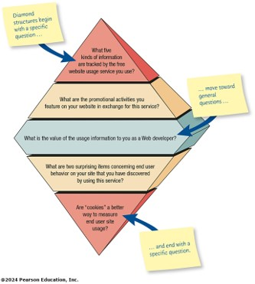
Figure 4.9 Diamond-Shaped Structure for Interviewing Combines the Pyramid and Funnel Structures
Notes:
Long Description:
The diamond structure begins with a specific question, move towards general questions and ends at the bottom with a specific question. Moving from top to bottom, the questions depicted are as follows.
1. What five kinds of information are tracked by the free website usage service you use?
2. What are the promotional activities you feature on your website in exchange for this service?
3. What is the value of the usage information to you as a Web developer?
4. What are two surprising items concerning end user behavior on your site that you have discovered by using this service?
5. Are “cookies” a better way to measure end user site usage?
A sticky note pointing toward the first question reads, diamond structures begin with a specific question, second one pointing toward the third question reads, move toward general questions, and the third one pointing toward the last question reads, and end with a specific question.

Slide 28
Closing the Interview
Always ask “Is there anything we haven’t touched on that you feel is important for me to know?”
Summarize and provide feedback on your impressions
Ask whom you should talk with next
Set up any future appointments
Thank them for their time and shake hands.
Notes:
“Is there anything we haven’t touched on that you feel is important for me to know?” —considered a formula question the response will often be “No.”
Inform the interviewee about the next steps to take.
Always remember to thank the interviewee for their time.

Slide 29
Interview Report
Write as soon as possible after the interview
Provide an initial summary, then more detail
Review the report with the respondent
Notes:
The longer you wait to write your report, the more suspect your data becomes.
Review the report with the respondent—helps clarify the meaning the interviewee had in mind and lets the interviewee know that you care.

Slide 30
Stories
Stories originate in the workplace
Organizational stories are used to relay some kind of information
When a story is told and retold over time it takes on a mythic quality
Isolated stories are good when you are looking for facts
Enduring stories capture all aspects of the organization and are the ones a systems analyst should look be seeking

Slide 31
Listening to Stories
Listening to stories is not efficient
It takes considerably more time than asking interview questions
Listening to stories may be more rewarding
Stories are more easily remembered than interview responses

Slide 32
Stories are Made up of Elements
All stories have these elements:
  The call to adventure
  The quest
  The struggle
  The transformation
  The resolution
  The moral
  The epilogue

Slide 33
Reasons for Telling Stories
Rich information from listening carefully to the stories is in itself valuable
The information gleaned from the stories will make more sense and be more valuable if seen in context

Slide 34
Business Stories
Business stories can be broken down into four important main types:
  Experiential stories
  Explanatory stories
  Validating stories
  Prescriptive stories

Slide 35
Stories and the Organization
Engage organization participants by reacting to stories
Match one story to another by recounting it to other participants, and collaborating with the stories
It is a way to deeply understand some of the problems associated with information systems

Slide 36
Purposes for Telling a Story
There are four purposes for telling a story:
  Experiential stories describe what the business or industry is like
  Explanatory stories tell why the organization acted a certain way
  Validating stories are used to convince people that the organization made the correct decision
  Prescriptive stories tell the listener how to act
Systems analysts can use storytelling as a complement to other information gathering methods

Slide 37
Joint Application Design (J A D)
Joint Application Design (J A D) can replace a series of interviews with the user community
J A D is a technique that allows the analyst to accomplish requirements analysis and design the user interface with the users in a group setting
Notes:
An alternative approach to interviewing users one by one.
Developed by IBM.
The motivation was to cut the time and hence the cost required by interviews. It also creates more use identification with new systems as a result of the participative process.

Slide 38
Conditions That Support the Use of J A D
Users are restless and want something new
The organizational culture supports joint problem-solving behaviors
Analysts forecast an increase in the number of ideas using J A D
Personnel may be absent from their jobs for the length of time required

Slide 39
Who is Involved
The people involved are:
  Executive sponsor
  I S analyst
  Users
  Session leader
  Observers
  Scribe
Notes:
All project team members must be committed to the J A D approach and become involved.
Executive sponsor—a senior person who will introduce and conclude the J A D session.
IS Analyst—gives an expert opinion about any disproportionate costs of solutions proposed.
Users—those who can articulate the information they need to perform their jobs, as well as what they desire in a new or improved computer system.
Session leader—someone who has excellent communication skills to facilitate appropriate interactions.
Observers—analysts or technical experts from other functional areas to offer technical explanations and advice.
Scribe—formally writes down everything that is done.

Slide 40
Where to Hold J A D Meetings
Offsite
  Comfortable surroundings
  Minimize distractions
Attendance
  Schedule when participants can attend
  Agenda
  Orientation meeting
Notes:
Hold offsite to minimize the daily distractions and responsibilities of the participants’ regular work.
Do not hold the session unless everyone can attend. An agenda should be given out before the meeting so the participants know what to expect. If possible, an orientation meeting can be held.

Slide 41
Benefits of J A D
Time is saved, compared with traditional interviewing
Rapid development of systems
Improved user ownership of the system
Creative idea production is improved
Notes:
Some organizations have estimated a 15 percent time savings over traditional.
Helps users become involved early in systems projects and treats their feedback seriously.
Much like brainstorming which allows for creative idea production.

Slide 42
Drawbacks of Using J A D
J A D requires a large block of time to be available for all session participants
If preparation or the follow-up report is incomplete, the session may not be successful
The organizational skills and culture may not be conducive to a J A D session
Notes:
It is not possible to do other activities concurrently or to time-shift any activities, as is typically done in one-to-one interviewing.
It is a judgmental decision if the organization is truly committed to, and prepared for, this approach.

Slide 43
Questionnaires
Questionnaires are useful in gathering information from key organization members about:
  Attitudes
  Beliefs
  Behaviors
  Characteristics
Notes:
Attitudes—what people in the organization say they want.
Beliefs—what people think is actually true.
Behavior—what organizational members do.
Characteristics—properties of people or things.

Slide 44
Planning for the Use of Questionnaires
Organization members are widely dispersed
Many members are involved with the project
Exploratory work is needed
Problem solving prior to interviews is necessary

Slide 45
Writing Questions
Questions are designed as either:
  Open-ended
    Try to anticipate the response you will get
    Well suited for getting opinions
  Closed
    Use when all the options may be listed
    When the options are mutually exclusive
Notes:
Even when you write an open-ended question, it must be narrow enough to guide respondents to answer in a specific way.
Use open-ended questions when it is impossible to list effectively all possible responses to a question.

Slide 46
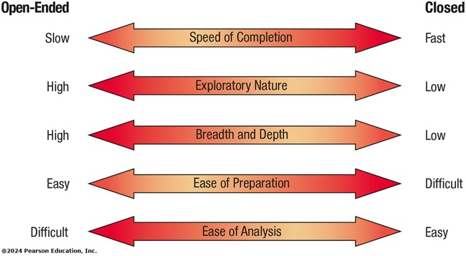
Figure 4.13 Trade-Offs between the Use of Open-Ended and Closed Questions on Questionnaires
Notes:
Long Description:
The information is as follows.
1. Speed of completion is slow in open ended question and fast in closed ended question.
2. Exploratory nature is high in open ended question and low in closed ended question.
3. Breadth and depth is high in open ended question and low in closed ended question.
4. Ease of preparation is easy in open ended question and difficult in closed ended question.
5. Ease of analysis is difficult in open ended question and easy in closed ended question.

Slide 47
Questionnaire Language
Simple
Specific
Short
Not patronizing
Free of bias
Addressed to those who are knowledgeable
Technically accurate
Appropriate for the reading level of the respondent
Notes:
Write questionnaires in the respondents own language usage.
Simple – use the language of the respondents whenever possible.
Specific – work at being specific rather then vague in wording.
Short – keep questions short.
Not patronizing – do not talk down to participants through low-level language choices.
Free of bias – also means avoiding objectionable questions.
Addressed to those who are knowledgeable – target questions to correct respondents.

Slide 48
Measurement Scales
The two different forms of measurement scales are:
  Nominal
  Interval
Notes:
Scaling is the process of assigning numbers or other symbols to an attribute or characteristic for the purpose of measuring that attribute or characteristic.

Slide 49
Nominal Scales
Nominal scales are used to classify things
It is the weakest form of measurement
Data may be totaled
What type of software do you use the most?
1 = Word Processor
2 = Spreadsheet
3 = Database
4 = An Email Program

Slide 50
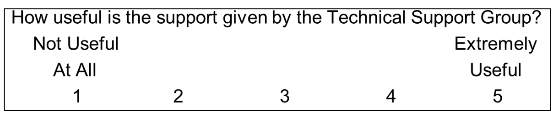
Interval Scales
An interval scale is used when the intervals are equal
There is no absolute zero
Examples of interval scales include the Fahrenheit or Centigrade scale
Notes:
More complete analysis can be performed on interval scales.

Slide 51
Validity and Reliability
Validity is the degree to which the question measures what the analyst intends to measure
Reliability of scales refers to consistency in response—getting the same results if the same questionnaire was administered again under the same conditions
Notes:
Questionnaires must be valid and reliable.

Slide 52
Problems with Scales
Leniency
Central tendency
Halo effect
Notes:
Construction of scales is a serious task, which must consider the problems associated with their construction.

Slide 53
Leniency
Caused by easy raters
  Solution is to move the “average” category to the left or right of center

Slide 54
Central Tendency
Central tendency occurs when respondents rate everything as average
  Improve by making the differences smaller at the two ends
  Adjust the strength of the descriptors
  Create a scale with more points

Slide 55
Halo Effect
When the impression formed in one question carries into the next question
Solution is to place one trait and several items on each page

Slide 56
Designing the Questionnaire
Allow ample white space
Allow ample space to write or type in responses
Make it easy for respondents to clearly mark their answers
Be consistent in style
Notes:
A well-designed, relevant questionnaire can help overcome some of the resistance to respond.

Slide 57
Order of Questions
Place most important questions first
Cluster items of similar content together
Introduce less controversial questions first
Notes:
You want respondents to feel as unthreatened by and interested in the questions being asked as possible, without getting overwrought about a particular issue.

Slide 58
Administering Questionnaires
Administering questionnaires has two main questions:
  Who in the organization should receive the questionnaire
  How should the questionnaire be administered

Slide 59
Figure 4.14 Ways to Capture Responses When Designing a Web Survey
Name | Appearance | Purpose
One-line text box | A single line text box is shown | Used to obtain a small amount of text and limit the answer to a few words
Scrolling text box | Multi line text box with horizontal and vertical scroll bars shown | Used to obtain one or more paragraphs of text
Check box | Checkbox is shown | Used to obtain a yes-no answer (e.g., Do you wish to be included on the mailing list?)
Radio button | Checked radio button | Used to obtain a yes-no or true-false answer
Drop-down menu | Image of a dropdown button is shown | Used to obtain more consistent results (Respondent is able to choose the appropriate answer from a predetermined list [e.g., a list of state abbreviations])
Push button | Push button, Image of a button labeled as Button is shown | Most often used for an action (e.g., a respondent pushes a button marked “Submit” or “Clear”)
Notes:
When you design questionnaires for the Web, apply the same rules you use when designing paper questionnaires.

Slide 60
Electronically Submitting Questionnaires
Reduced costs
Collecting and storing the results electronically
Notes:
Reminders can be sent.

Slide 61
Requirements Prioritization
Six methods used for requirement prioritization include:
  Simple Ranking
  100-token Method
  M o S C o W Method
  Urgent/Important Matrix
  Analytic Hierarchy Processing (A H P)
  Q-Sorts
Notes:
Involves the client or customer.

Slide 62
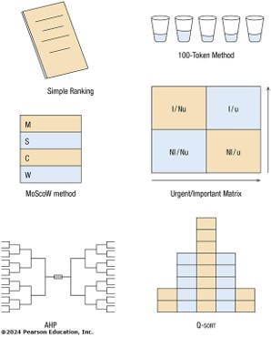
Figure 4.15 Six Methods Used for Requirements Prioritization
Notes:
Long Description:
The six methods along with the diagrams are as follows.
1. Simple ranking. A form is shown.
2. 100 token method. Five glasses filled with different levels of water is shown.
3. MoScow method. A table with 4 rows with letters M, S, C, and W from top to bottom.
4. Urgent or important matrix. A 2 by 2 matrix is shown. Upper left cell is labeled, I or N u. Upper right cell is labeled, I or U. Lower left cell is labeled, N I or N u. Lower right cell is labeled, N I or U.
5. A H P. Two connected tree diagrams.
6. Q sort. 8 piles showing increasing grid from bottom to top.

Slide 63
Simple Ranking
Interested parties are asked to rank-order a list of requirements
Works best with a short list of 10 or less

Slide 64
100-Token Method
Each participant within a group is given 100 tokens which they can distribute as votes across the available items.
The votes do not need to be distributed equally; rather a weighted distribution can be used to reflect the higher priority that some items warrant.

Slide 65
M o S C o w Method
Participants are asked to put the requirement into one of the four categories
  Must
  Should
  Could
  Won’t
Notes:
Must means that a requirement must be completed for the project to be considered a success.
Should means that the requirement should be included if there is time and money available to do so, but if they are not,
the project can still be deemed a success.
Could means that after all the must and should categories have been completed, a requirement could be considered. It might add some value but does not have to be included.
Won’t requirements are those that will not be adopted at this time.

Slide 66
Urgent/Important Matrix
Prioritizing requirements bases on the level of urgency and importance of each task
Matrix is drawn in which the x-axis shows urgency and the vertical y-axis represents importance
Notes:
Using a simple grid, the matrix defines tasks according to their importance and urgency.

Slide 67
Analytic Hierarchy Processing (A H P)
More complex and time-consuming method
Pairs of alternatives are presented to participants and each participant decides which of the two are more important.
Notes:
A metaphor for this type of method is similar to the NCAA March Madness basketball event where the winners move up to play another game and the losers drop out.

Slide 68
Q-Sorts
Participants are assigned the task of sorting a number of requirements by placing a specific number of requirements in a predetermined distribution pattern (e.g., a normal distribution) along a spectrum of ranking categories from most important to least important.
Notes:
The cards are distributed in a normal distribution. In an example of 24 requirements, the piles from the right (most important) to the left (least important) should hold 2, 5, 10, 5, 2, respectively.

Slide 69
Summary (1 of 2)
Interviewing
  Interview preparation
  Question types
  Arranging questions
  The interview report
Joint Application Design (J A D)
  Involvement and location

Slide 70
Summary (2 of 2)
Questionnaires
  Writing questions
  Using scales and overcoming problems
  Design and order
  Administering and submitting
  Stories
  Story elements
Requirement prioritization
  Six methods to help users prioritize

Slide 71

Copyright
This work is protected by United States copyright laws and is provided solely for the use of instructors in teaching their courses and assessing student learning. Dissemination or sale of any part of this work (including on the World Wide Web) will destroy the integrity of the work and is not permitted. The work and materials from it should never be made available to students except by instructors using the accompanying text in their classes. All recipients of this work are expected to abide by these restrictions and to honor the intended pedagogical purposes and the needs of other instructors who rely on these materials.

